Slide 1
ISAP Workshop

Slide 2



ISAP Workshop
Dan Conley
Director of In-School AP
daniel.conley@coopacademies.co.uk

Slide 3


Impetus
Adam Alagiah-Glomseth (Investment Director)
Georgia Brown (Investment Manager)

Slide 4
Current Challenges
Write down your current top 3 challenges as an ISAP
Attendance Strategies
Academic Progress
SEMH Progress / Interventions
Suspensions / PEX outcomes
Reintegration
Aspirations / Careers / Post-16 Destinations

Slide 5
Survey of Top 3 Challenges
Attendance | Academic Progress | SEMH Progress | Suspensions / PEX | Reintegration | Aspirations
10 | 2 | 8 | 0 | 9 | 2

Slide 6
Choose A Working Group
No more than one school per group!
Attendance
Academic Progress
SEMH Progress
Suspensions / Exclusions
Reintegration
Aspirations / Careers / Post-16

Slide 7
Table Groups
Attendance
Academic Progress
SEMH Progress
Suspensions / Exclusions
Reintegration
Aspirations / Careers / Post-16
Current Strategies
Development Ideas
Potential Barriers
Solutions / Support Needed
Actions / To Do List
Share Contact Details

Slide 8
Objectives
Collaboration of top areas of challenge
ISAP Review Process & Impact Assessment
Portal / Wider Curriculum / Portfolios

Slide 9
Objectives
Collaboration of top areas of challenge
ISAP Review Process & Impact Assessment
Portal / Wider Curriculum / Portfolios

Slide 10
ISAP Review Process
Prior to breaking up for Christmas:
ISAP Review Form for each student
Dashboard will calculate impact for you!

Slide 11
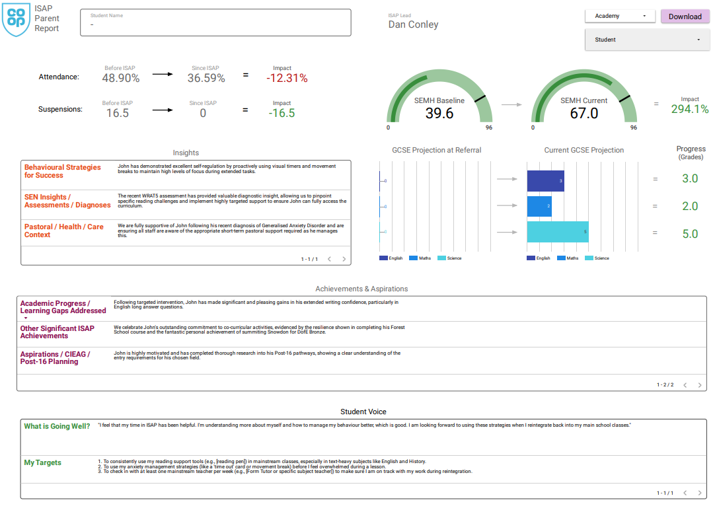
Review

Slide 12
Impetus Review: 2/2/2026
Deadline: End of Term
SEMH Tracker for all ISAP Students
Gather Projected Eng / Maths / Sci Grades
ISAP Review Google Form
Feeds into School Trust Reviews
Parental Reports

Slide 13
Objectives
Collaboration of top areas of challenge
ISAP Review Process & Impact Assessment
Portal / Wider Curriculum / Portfolios

Slide 14
Objectives
Collaboration of top areas of challenge
ISAP Review Process & Impact Assessment
Portal / Wider Curriculum / Portfolios

Slide 15
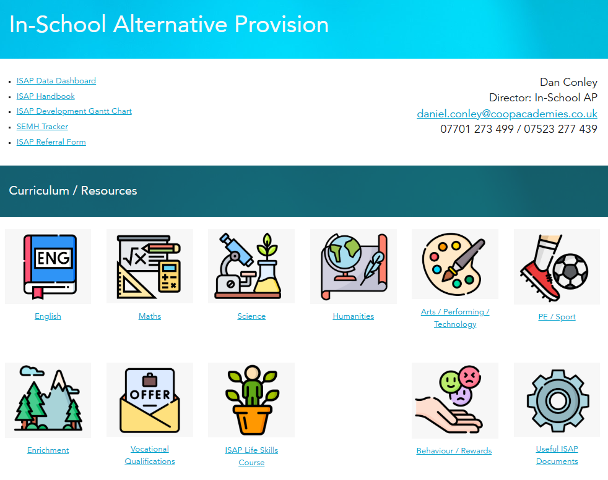
Portal

Slide 16
Wider Curriculum / Life Skills
Half Term |  | Topic
1 | ❤️‍🩹 | Personal Health & Wellbeing: Self-care, understanding one's own body and mind, and making healthy choices.
2 | 💸 | Money Skills: Crucial for preparing students for financial independence and responsibility.
3 | 🍕 | Independent Living: Essential skills needed for independent living including cooking and basic DIY.
4 | 🧠 | Study Skills: Focusing on developing effective learning strategies to succeed in and out of the classroom.
5 | 🌳 | Careers, Hobbies and Growth: Helping students explore their interests and prepare for future pathways, including exploring volunteering.
6 | 💭 | The Big Questions: Introducing students to key philosophical concepts and coaching students on how to engage in debate.

Slide 17


AQA Unit Award Scheme
Search for Units Here
Ask about accredited staff
Units ‘unlock’ access to lesson readmission
Ask Headteachers to award these so students are ‘seen’
Portfolio of Achievements!

Slide 18


Portfolio of Achievement

Slide 19
Recap
Collaboration of top areas of challenge
ISAP Review Process & Impact Assessment
Portal / Wider Curriculum / Portfolios

Slide 20
ISAP Network Meeting: 27/11
Make contact with another ISAP!
Attendance
Academic Progress
SEMH Progress
Suspensions / PEX
Reintegrations
Aspirations / Careers / Post-16

Slide 21
Thank You!
Dan Conley
Director of In-School AP
daniel.conley@coopacademies.co.uk

